Slide 1
K-Nearest Neighbours (KNN)
Non Parametric, Lazy, Multi Class Classification Technique

Slide 2


K-NN
KNN algorithm is one of the simplest classification algorithm and it is one of the most used learning algorithms.
KNN can be used for classification — the output is a class membership (predicts a class — a discrete value). An object is classified by a majority vote of its ‘k’ neighbors, with the object being assigned to the class most common among its k nearest neighbors.

Slide 3


Features
KNN stores the entire training dataset which it uses as its representation.
KNN does not learn any model.
KNN makes predictions just-in-time by calculating the similarity between an input sample and each training instance.

Slide 4



Lazy
KNN is a lazy algorithm (as opposed to an eager algorithm). This means it does not use the training data points to do any generalization.
In other words, there is no explicit training phase or it is very minimal. This also means that the training phase is pretty fast . Lack of generalization means that KNN keeps all the training data.
To be more exact, all (or most) the training data is needed during the testing phase.

Slide 5


Non-Parametric
KNN does not make any assumptions on the underlying data distribution. In other words, the model structure is determined from the data.
If you think about it, it’s pretty useful, because in the “real world”, most of the data does not obey the typical theoretical assumptions made (as in linear regression models, for example).
Therefore, KNN could and probably should be one of the first choices for a classification study when there is little or no prior knowledge about the distribution data.

Slide 6
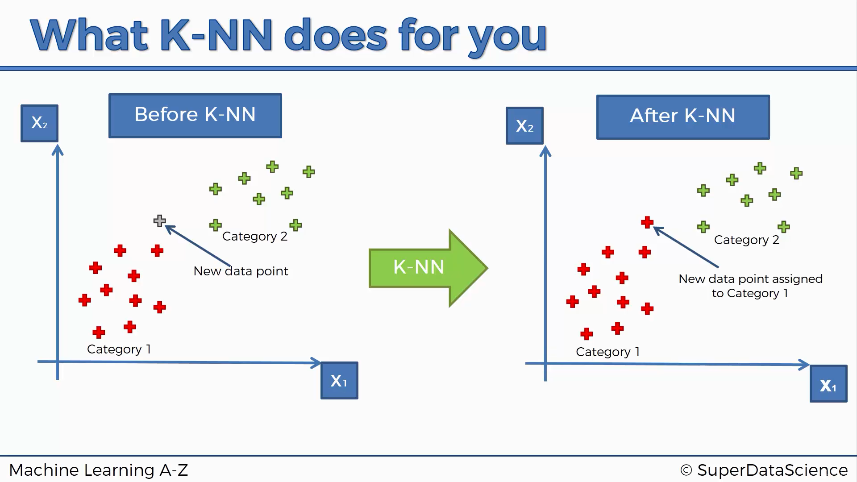

Slide 7
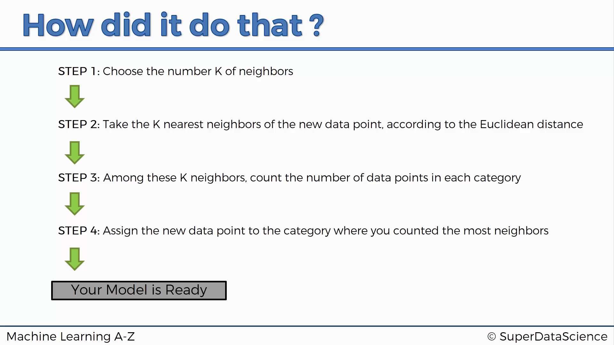

Slide 8
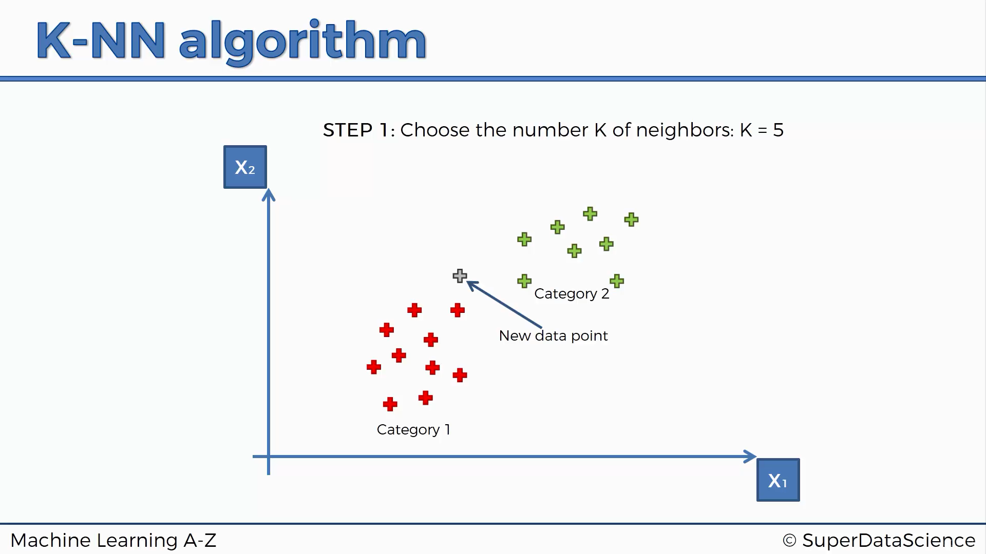

Slide 9
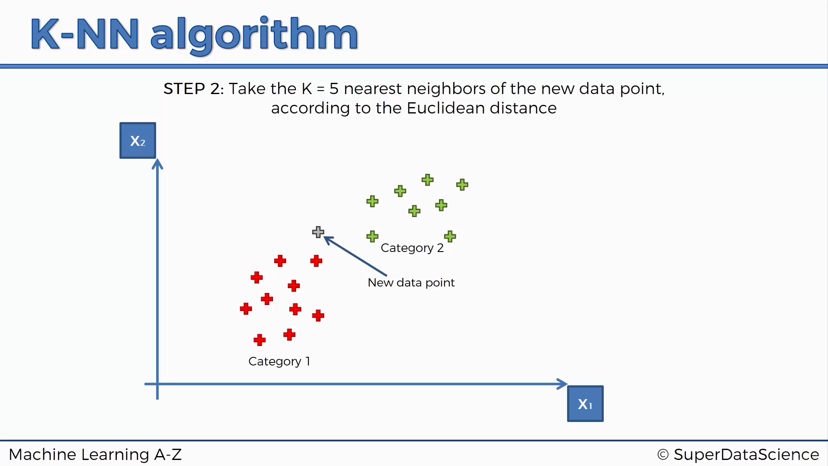

Slide 10
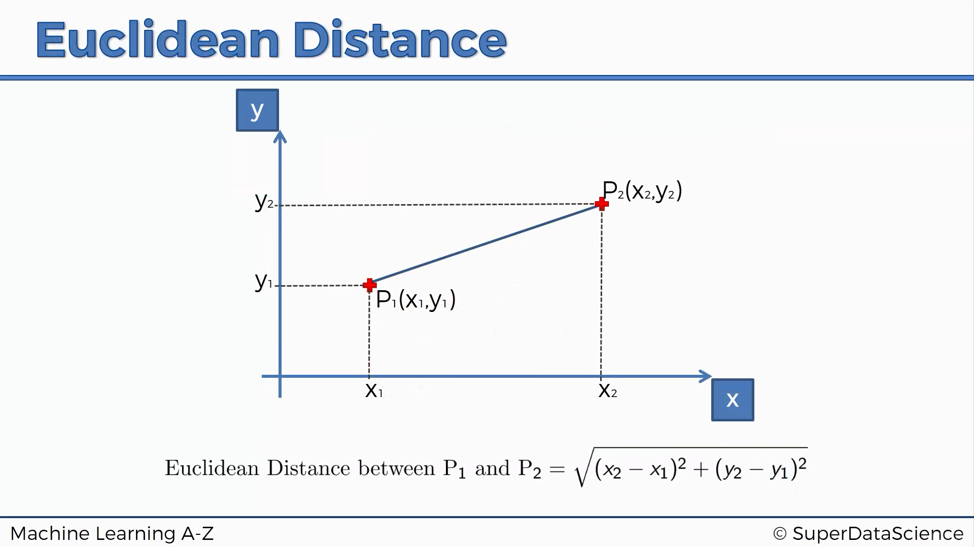

Slide 11
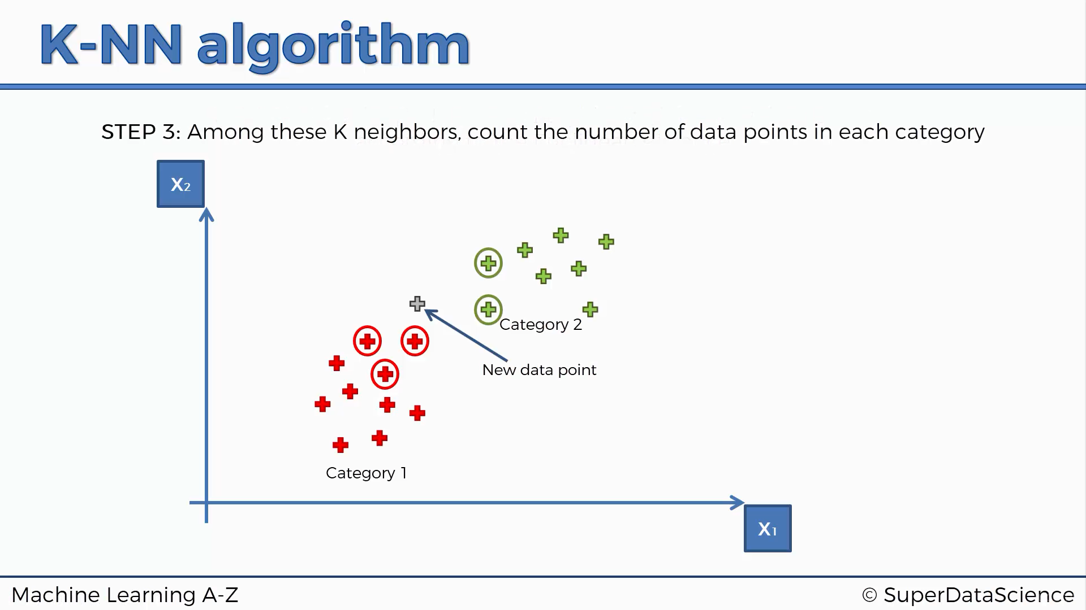

Slide 12
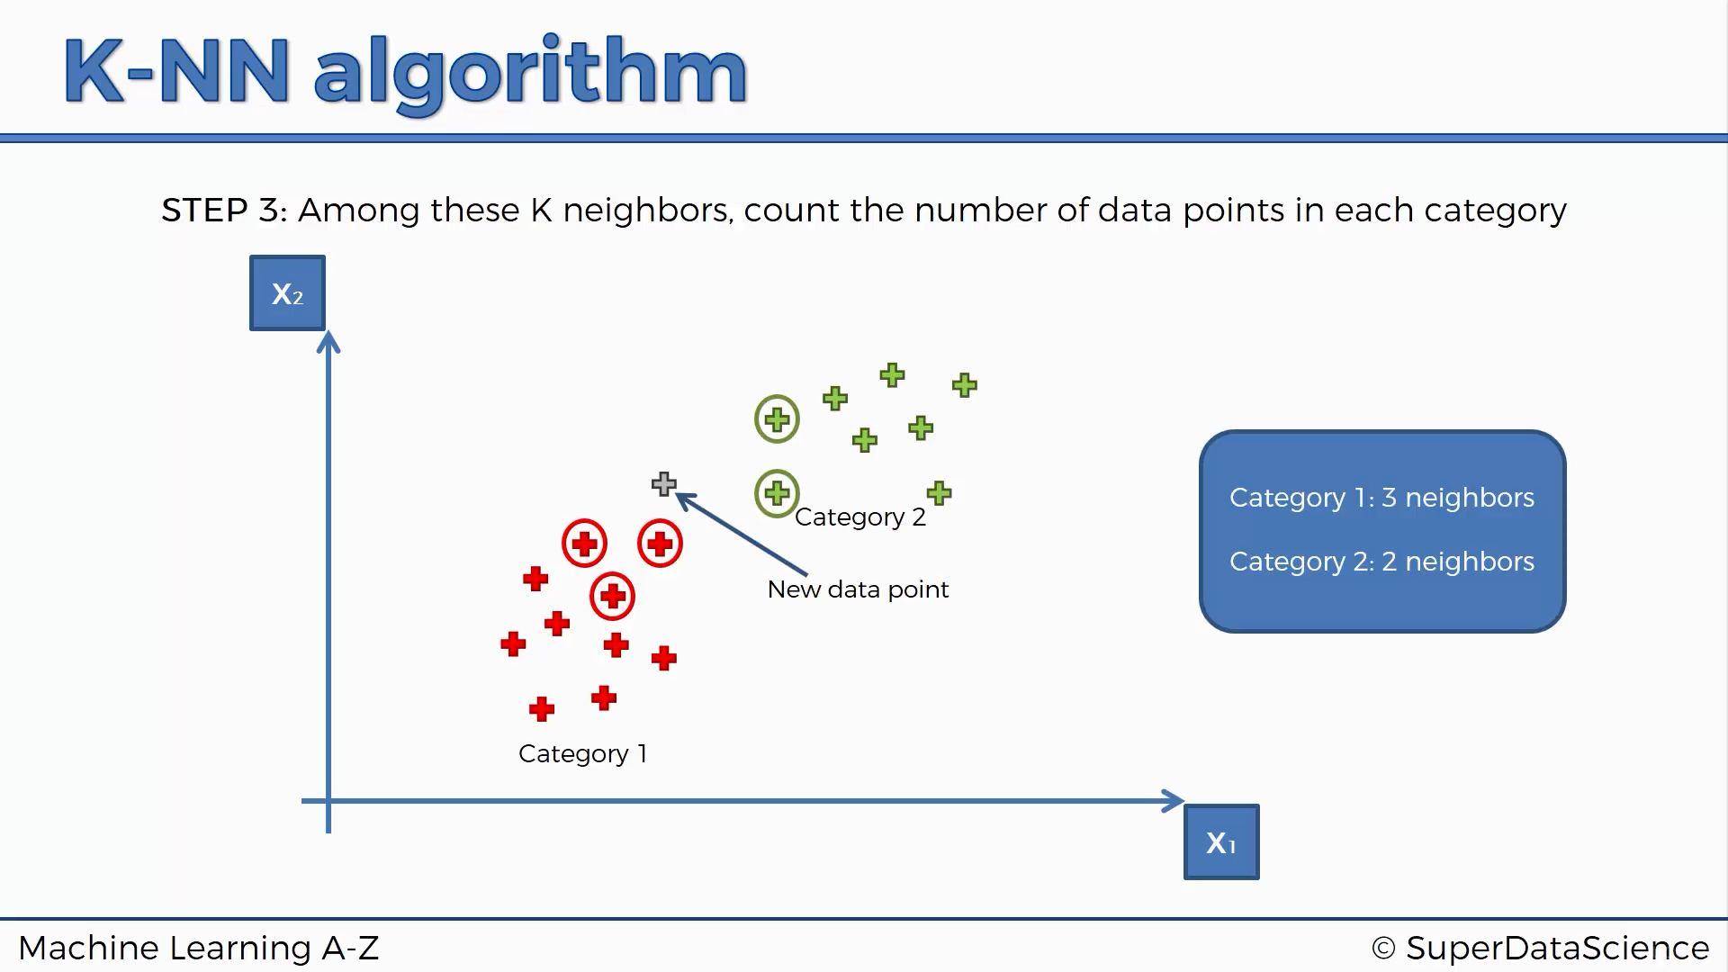

Slide 13
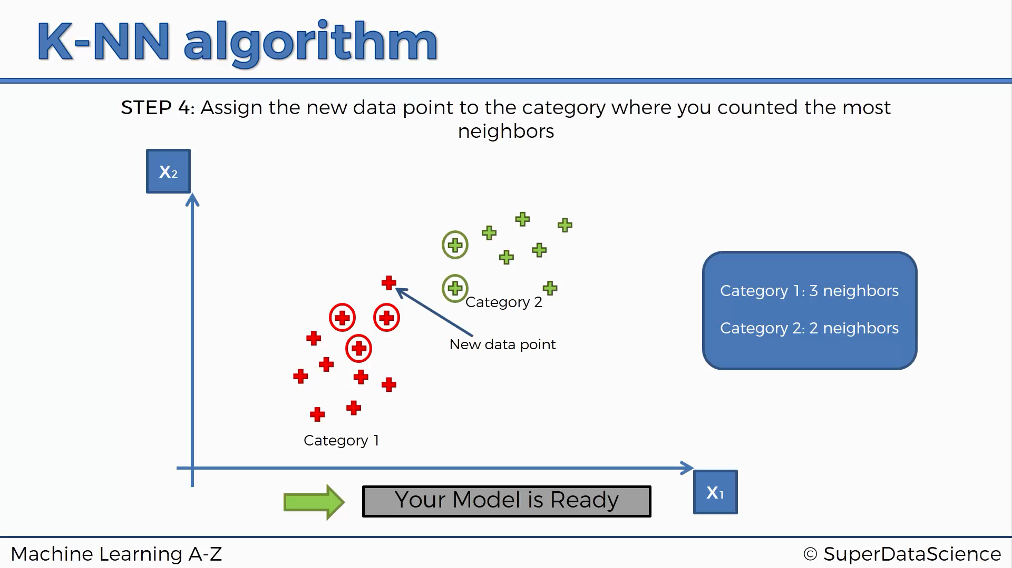

Slide 14
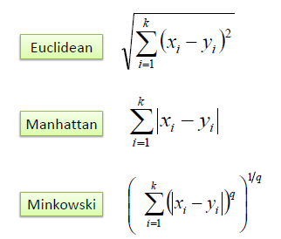
Ways to find Distances:
It should also be noted that all three distance measures are only valid for continuous variables. In the instance of categorical variables the Hamming distance must be used. It also brings up the issue of standardization of the numerical variables between 0 and 1 when there is a mixture of numerical and categorical variables in the dataset.

Slide 15
K? How many?
Choosing the optimal value for K is best done by first inspecting the data. In general, a large K value is more precise as it reduces the overall noise but there is no guarantee.
Cross-validation is another way to retrospectively determine a good K value by using an independent dataset to validate the K value.
Historically, the optimal K for most datasets has been between 3-10. That produces much better results than 1NN.

Slide 16
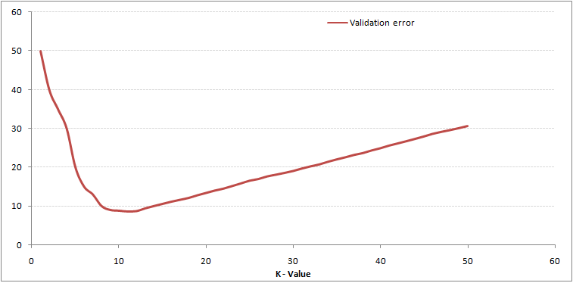
This makes the story more clear. At K=1, we were overfitting the boundaries. Hence, error rate initially decreases and reaches a minima. After the minima point, it then increase with increasing K. To get the optimal value of K, you can segregate the training and validation from the initial dataset. Now plot the validation error curve to get the optimal value of K. This value of K should be used for all predictions.

Slide 17

Standardized Distances
One major drawback in calculating distance measures directly from the training set is when variables have different measurement scales or there is a mixture of numerical and categorical variables.
For example, if one variable is based on annual income in dollars, and the other is based on age in years then income will have a much higher influence on the distance calculated. One solution is to standardize the training set.
Do Feature Scaling before making the K-NN model.

Slide 18





How to handle categorical variables in KNN?
Create dummy variables out of a categorical variable and include them instead of original categorical variable.
Unlike regression, create k dummies instead of (k-1).
For example, a categorical variable named "Department" has 5 unique levels / categories. So we will create 5 dummy variables. Each dummy variable has 1 against its department and else 0.

Slide 19
Advantages
Easy to understand
No assumptions about data
Can be applied to both classification and regression
Works easily on multi-class problems

Slide 20


Disadvantages
Computationally expensive — because the algorithm stores all of the training data
High memory requirement - Stores all (or almost all) of the training data
Does not work well with rare erroneous events in the data
Struggles with high number of independent variables

Slide 21

Applications & Examples
Credit ratings — collecting financial characteristics vs. comparing people with similar financial features to a database. By the very nature of a credit rating, people who have similar financial details would be given similar credit ratings. Therefore, they would like to be able to use this existing database to predict a new customer’s credit rating, without having to perform all the calculations.
Should the bank give a loan to an individual? Would an individual default on his or her loan? Is that person closer in characteristics to people who defaulted or did not default on their loans?
Handwriting detection (like OCR), image recognition and even video recognition.

Slide 22


Can K-NN be used for Regression?
Yes, K-nearest neighbor can be used for regression. In other words, K-nearest neighbor algorithm can be applied when dependent variable is continuous.
In this case, the predicted value is the average of the values of its k nearest neighbors.

Slide 23
Python’s sklearn Documentation
http://scikit-learn.org/stable/modules/neighbors.html
http://scikit-learn.org/stable/modules/generated/sklearn.neighbors.KNeighborsClassifier.html

